Slide 1

Introduction to Computer Science: Programming Methodology
Tutorial 1
Introduction
Kaiyan ZHENG, FE
Sept. 14 2023
kaiyanzheng@link.cuhk.edu.cn

Slide 2
Outline
Teaching fellows
Schedule for tutorials
Install Python
About assignments and exams
Some tips
An example

Slide 3
Teaching fellows
Instructors:
Prof HAN, Xiaoguang (L02)
Prof ZHAO Junhua(L03 / L04)
Prof SUN Qilin(L05)
Prof HE Pinjia (L06)

Slide 4
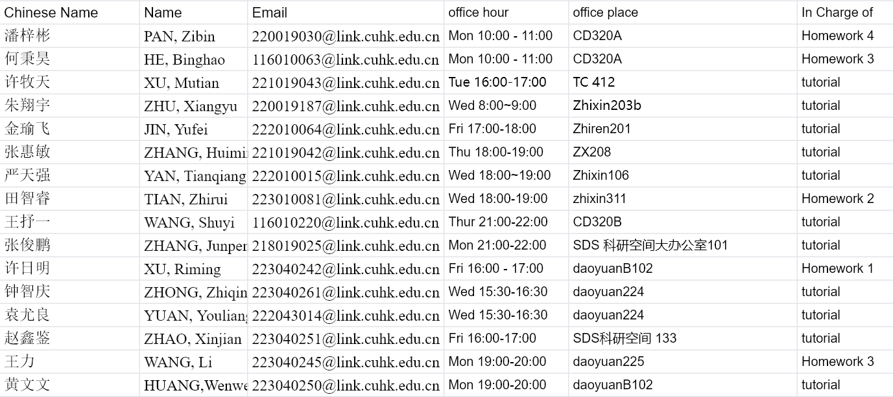
Teaching fellows
Office Hour of TAs:

Slide 5
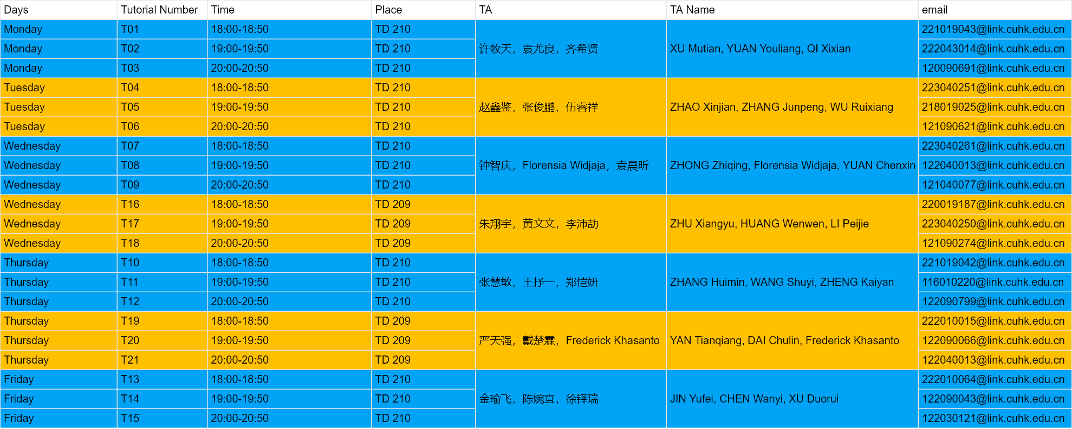
Timetable
Arrangement of Tutorials:
The materials of tutorials can be downloaded from Onedrive, the link can be seen in the blackboard.

Slide 6
Note
The materials of tutorials can be downloaded from Onedrive, the link can be seen in the blackboard.
I and the other two TA are responsible for the Tutorial on Thursday, and we take a shift every 3 weeks

Slide 7
Survey: How many of you have learned programming before?

Slide 8
For CSC1001
Before taking this course, I had absolutely no prior programming experience.
It was all new territory for me, just like it might be for some of you. However, I approached the course with
Dedication,
Willingness to learn,
Practice.
I made sure to thoroughly understand the material and practice regularly.
So don’t be afraid!

Slide 9
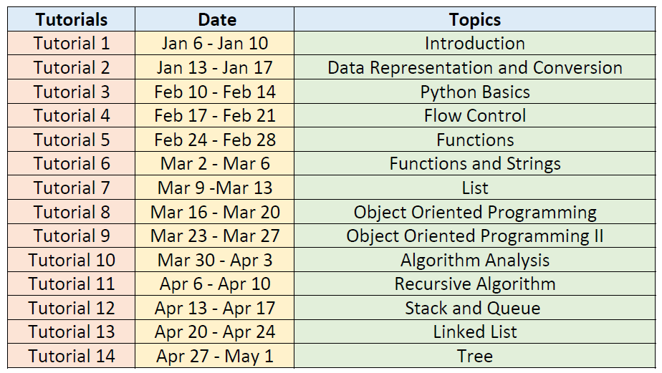
Schedule
I will be here every 3 weeks

Slide 10
What we do in tutorials?
Writing python codes to solve problems. Around 3~6 problems in one tutorial.
TAs may explain the algorithms and python codes, or discuss and answer some questions from students about the lectures.

Slide 11
What is the computer programming?
Computer programming is the process that professionals use to write code that instructs how a computer, application or software program performs.
Code → Programs → Software / websites / apps …
What job can we take after learning computer programming?

Slide 12
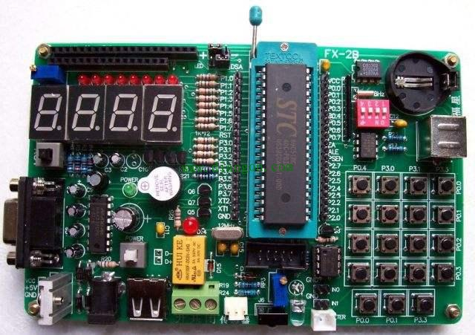
Why we choose to learn Python?
What is the computer programming language?
Your code→ … → Machine instructions → Execution.
So, why do we choose to learn Python?

Slide 13
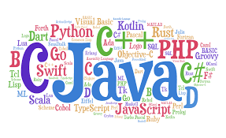

Slide 14
Low Level Language and High Level Language.
Assembly language is a low level language. It’s very difficult to use.
C, C++, Python, Java, C#… are high level language.
Executing efficiency VS coding efficiency.
However, …
Learning Python in this term helps you open a gate to the programming world. So grasp this opportunity!

Slide 15
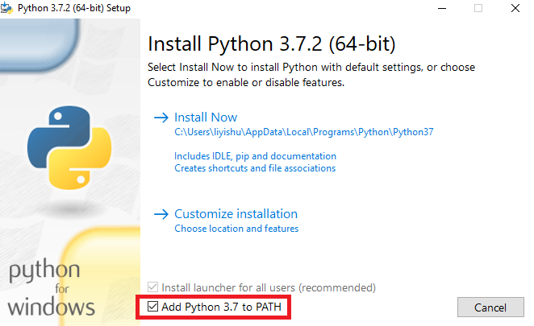
Installation Steps
Download stable version (3.6 or 3.7) from https://www.python.org/
Do remember to download the correct version for your own platform (Windows/Linux/MacOS)
Install step by step.
Make sure you’ve added Python path to environment variables.
Some students prefer using “PyCharm”, having more functionalities. You could google or baidu to download and install it.

Slide 16
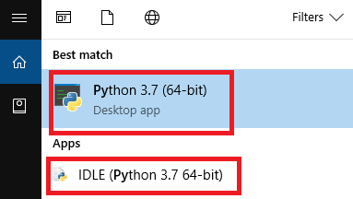
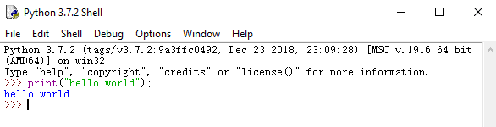
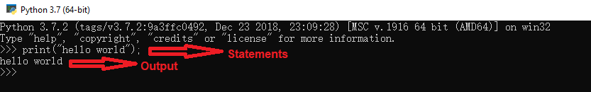
How to write and run the program
Search “python” in start menu (Windows)
Open Python desktop app or IDLE.
You can write your code statement under shell (e.g. type “print(“hello world”);”
Press enter and then the code will be executed. (“hello world” will be printed)

Slide 17
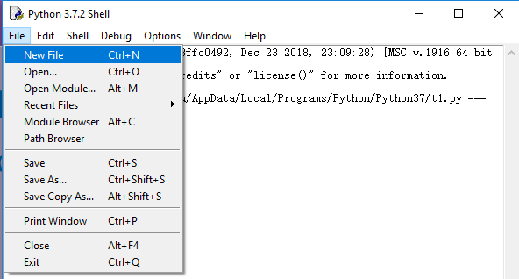
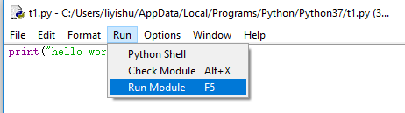
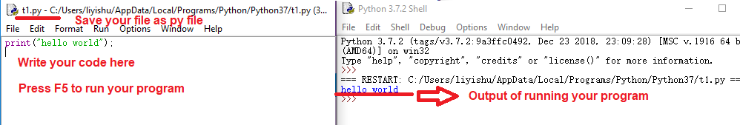
How to write and run the program
In IDLE, you can also open or new a py file. Write your code in this file, and then press “F5” (or “Run” -> “Run Module”) to run your program.

Slide 18
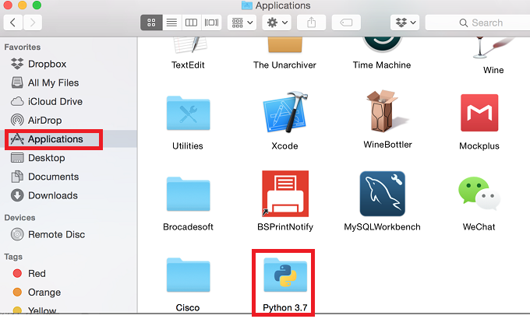
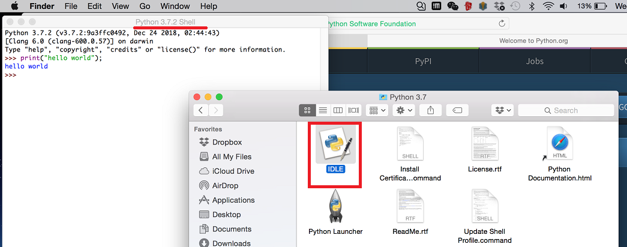
How to write and run the program
For MacOS, you will find a folder named “Python 3.7” being displayed under Application.
Double click “IDLE” and you will see the Shell and can write your py file or write your code in shell directly.

Slide 19
A better software…
Rather than utilize idle, I recommend you to download Anaconda, the “spyder” ide from it is very useful.
IDEs help you manage your program projects.
Some famous IDEs: Spyder, Pycharm, Vscode, …
Show time…

Slide 20
knowledge points of Python
identifier
basic grammars
variables’ type
operator
conditional statement, loop statement
string
list, tuple, dictionary
function

Slide 21
knowledge points of Python
module
file, I/O
OOP: Object-oriented Programming

Slide 22
Key point
In order to improve your programming skill, you must try your best to write more code.
Write comments when coding. The volume of comments need to cover over 1/3 of your codes.

Slide 23
About assignments and exams
Assignments:
You will receive problem-solving tasks.
Write code to solve the problems and create a PDF file with explanations.
Compress both the code (.py) and explanation (.pdf) into one file.
Upload the zipped file to the blackboard system before the deadline.
Late submissions will incur point deductions.
Submissions more than three days after the deadline will not be accepted.

Slide 24
About assignments and exams
Exams:
Exams are in paper format.
They include questions related to lecture notes and coding tasks.
You'll need to demonstrate your understanding of course materials and code-writing skills during exams.

Slide 25
Some tips
Learning Approach: Focus on your lecture notes and practice extensively.
Problem Solving: Remember that while programs help solve problems, it's your understanding and algorithm design that matter most. Think of the computer as a tool to calculate quickly.
Progressive Learning: Before the midterm, master basic tools like data types, if-else statements, and loops, which are like a designed calculator. Use them to solve simpler problems on your own.
Post-Midterm: After the midterm, delve into more abstract concepts such as functions, classes, algorithms, and complex data structures like lists and trees. Combine these tools to create complex and functional "machines."

Slide 26
An example: get email addresses
Problem: Once I need to send an email to a large amount of students, but I only get a file with their student ids. How can I get a file with their email addresses.
Solution: To solve it, just import the id file and add “@link.cuhk.edu.cn” after that, and write into a new file.

Slide 27
An example: get email addresses
Meaningful Variable Names: Use descriptive words to represent variables for easy understanding and remembering their purpose.
Comments with “#”: Utilize comments in your code, marked with “#” to explain critical parts of your algorithm and provide clarity.

Slide 28
Announcement
Remember to bring your laptop next time!

Slide 29
Any questions or suggestions?

